Slide 1
To click or not to click? Recognizing and protecting oneself from phishing
Public workshop
Browsing in
a digital society
Notes:
Ethical Guidelines and Code of Conduct
Procedure - Dispute or Non-Compliance with the Code of Conduct
Technical Procedures
INTRODUCE YOURSELF
Hello! My name is (...). I’m a (...) with Techno Culture Club. We’re a Montreal-based organization specializing in the creation and dissemination of content related to digital literacy.
This workshop is being offered as part of the AlphaNumérique project.
AlphaNumérique is a national initiative that aims to help bridge the digital divide. For more information, please visit https://alphanumerique.ca.
SHARE THIS TEXT IN THE CHAT ROOM
Please note that this workshop is being recorded for internal training and quality control purposes. Under no circumstances will the recording be shared online or with a third party.
BEFORE STARTING THE WORKSHOP: CONDUCT A ZOOM SURVEY TO CONFIRM THAT EVERYONE IS CONNECTED TO THE AUDIO AND THAT PARTICIPANTS ARE COMFORTABLE WITH THE PLATFORM.
AUDIO HELP AVAILABLE HERE.
ZOOM HELP AVAILABLE HERE.

Slide 2
Program
1. What is phishing?
2. How to recognize phishing by email?
3. What to do in case of doubt?
4. What to do if you are a victim of online fraud?
Notes:
Slide 2
This workshop will answer the following questions:
What is phishing?
How do you spot a phishing email?
What should you do if you’re not sure?
What should you do if you fall victim to an online scam?
Over the course of the workshop, we’ll deal with several types of phishing. But we’ll focus on email and text message scams.

Slide 3
The floor is yours!
Have you ever been in a situation where you experienced phishing or fraud or do you know anyone who has?
Notes:
Slide 3
Have you ever personally had to deal with a phishing attempt or another type of online scam? If not, do you know someone who has?
------------------------------

Slide 4
1. What is phishing?
Notes:
Slide 4
Let’s start by defining “phishing.”
------------------------------

Slide 5
Definition of phishing
“Phishing is a general term for emails, text messages and websites fabricated and sent by criminals and designed to look like they come from well-known and trusted businesses, financial institutions and government agencies in an attempt to collect personal, financial and sensitive information.”
Source : Canadian Centre for Cyber Security
Notes:
Slide 5
According to the Canadian Centre for Cyber Security, “phishing” is a general term for emails, text messages and websites fabricated and sent by criminals and designed to look like they’re from well-known and trusted businesses, financial institutions and government agencies. Criminals use phishing scams to collect personal, financial and sensitive information.
------------------------------

Slide 6
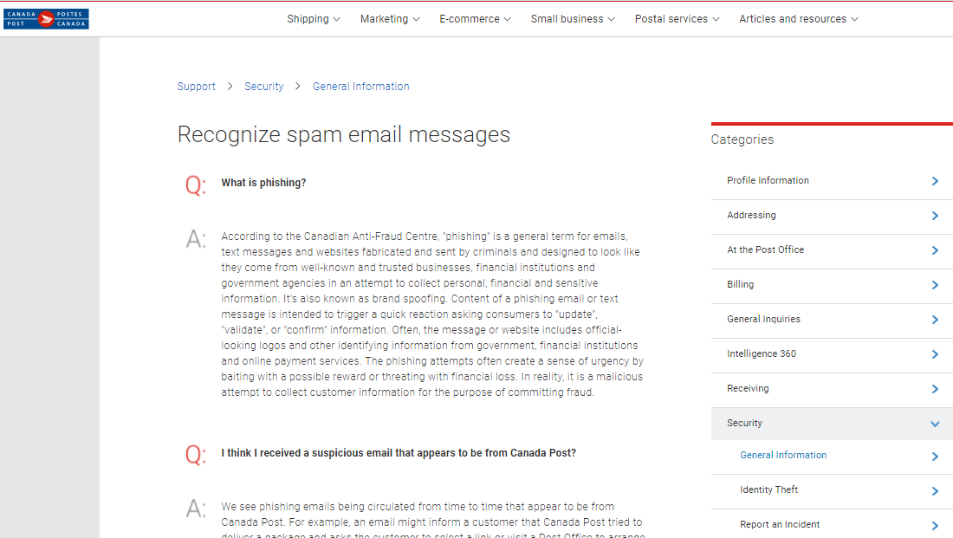
Definition of phishing
Notes:
Slide 6
------------------------------
The Canada Post website explains that the content of a phishing email or text message is designed to trigger a quick reaction from Internet users by asking them to “update,” “validate,” or “confirm” information.
------------------------------
Phishing messages and websites often contain official-looking logos or other information referring to government agencies, financial institutions or online payment services. Phishing attempts often create a sense of urgency by raising the prospect of a reward or by threatening financial loss.
In reality, the message is a malicious attempt to gather information on an Internet user with the aim of committing fraud.
------------------------------

Slide 7
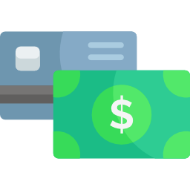
Goals of phishing
Theft of banking information
Identity theft
Falsification of documents
Notes:
Slide 7
Criminals who use phishing scams normally do so with one of the following goals in mind:
Committing payment card fraud.
Committing identity theft.
Creating counterfeit documents.

Slide 8
Did you know?
Notes:
Slide 8
Let’s watch a short CityNews report on scams targeting Canadians.
------------------------------

Slide 9
Different methods used by fraudsters
Telephone call
Text message and email
Malicious website
Notes:
Slide 9
Fraudsters use a variety of means to contact potential victims. Phishing attempts can be made by:
Telephone
Text message
Email
Phishing attempts often involve malicious websites.
------------------------------
Today, we’re going to focus on email fraud. This type of phishing often seeks to manipulate an Internet user’s emotions and cause them to react impulsively. Such scams encourage users to reveal personal information in response to a message or through a form on a phony website.
------------------------------

Slide 10
7 warning signals of a phishing message
1. Pressure or threatening language
5. Dubious information
2. Sensitive information asked
6. Suspicious attachments
3. Too good to be true
7. Dubious grammar or syntax
4. Unexpected emails
Notes:
Slide 10
Here are the seven red flags of phishing, as described on the Government of Canada’s “Get Cyber Safe” website (https://www.getcybersafe.gc.ca). Keep in mind that text phishing scams use exactly the same techniques.
------------------------------
1. Urgent or threatening language Authentic urgent messages are rarely sent by email.
------------------------------
2. Requests for sensitive information
Trusted organizations and individuals rarely ask for this type of information via email.
------------------------------
3. Anything too good to be true
Chances are, you didn’t win a lottery you didn’t enter and you won’t be getting an inheritance from a relative you’ve never heard of!
------------------------------
4. Unexpected emails
Be suspicious of messages with receipts or inquiries related to items you didn’t order.
------------------------------
5. Information mismatches Keep an eye out for clues that a message might be a phishing attempt. Here are some things to look for:
Is the sender’s email address correct?
Do the links lead to an official website?
Are there any spelling or grammatical errors that a legitimate organization wouldn’t miss?
------------------------------
6. Suspicious attachments
Never trust attached files with strange extensions or names.
------------------------------
7. Poor grammar or syntax
Criminals don’t always take the time to correct their English before sending a phishing message! Messages from a credible organization are unlikely to have issues with syntax or grammar.
------------------------------

Slide 11
2. How to recognize phishing by email?
Notes:
Slide 11
2. How do you spot a phishing email?
------------------------------

Slide 12
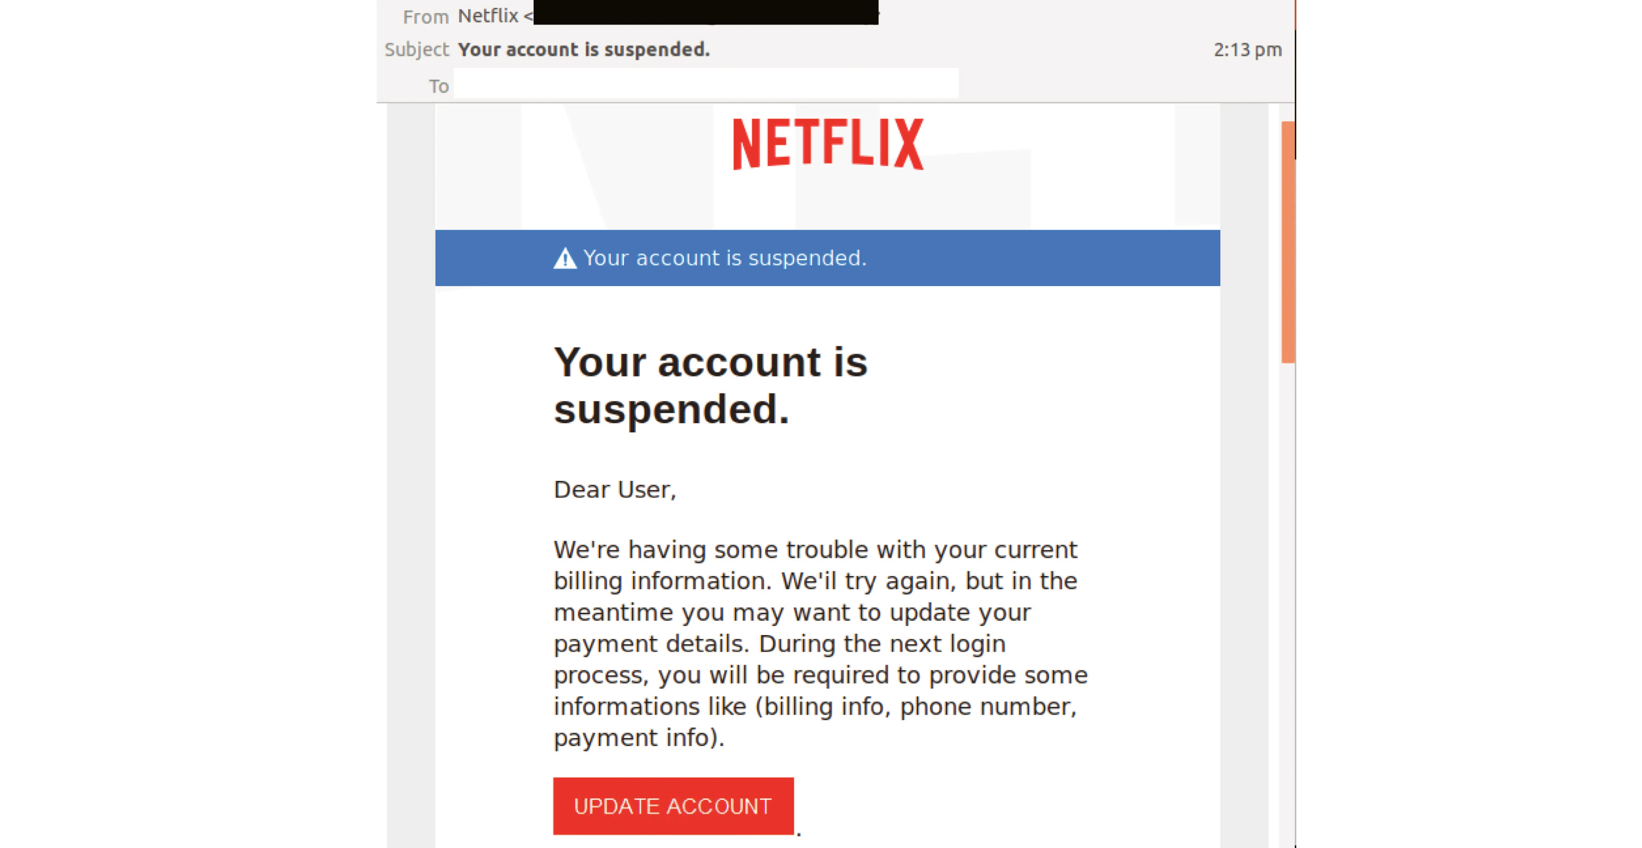
Update your payment details
Notes:
Slide 12
Now, let’s look at several examples of red flags that may appear in phishing messages.
Here’s an example of a message that uses urgent or threatening language.
The subject line indicates that the user’s account has been suspended.
The body of the message asks the user to update their payment information by clicking on the red “UPDATE ACCOUNT”
button.
The message contains several red flags:
------------------------------
1. The email is unexpected and puts pressure on the recipient to take urgent action. This sense of urgency is reinforced by the subject line that threatens a negative outcome and includes several exclamation points.
------------------------------
2. The kind of sensitive information asked for in the message is not normally requested via email.
------------------------------
3. The text contains spelling and grammar errors.
------------------------------
Let’s move on to a second example.
------------------------------

Slide 13
Notes:
Slide 13
In this case, the phishing message raises other red flags. This fraudulent email informs the recipient that they are eligible for a rebate due to the COVID-19 pandemic. The user is invited to visit the Hydro-Québec “Customer Space” by clicking on a link.
------------------------------
1. This message promises an unexpected windfall for reasons that are not entirely clear. A power company would normally send this type of notice by mail.
------------------------------
2. The text contains spelling and grammar errors that a major utility would normally not make in such a message.
------------------------------
3. The email was not sent from a Hydro-Québec address.
------------------------------

Slide 14
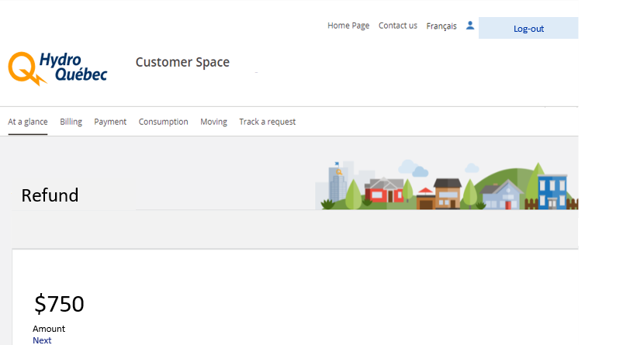
Notes:
Slide 14
The link provided redirects the user to a malicious site where they are asked to provide personal information so they can receive the promised rebate.
------------------------------

Slide 15
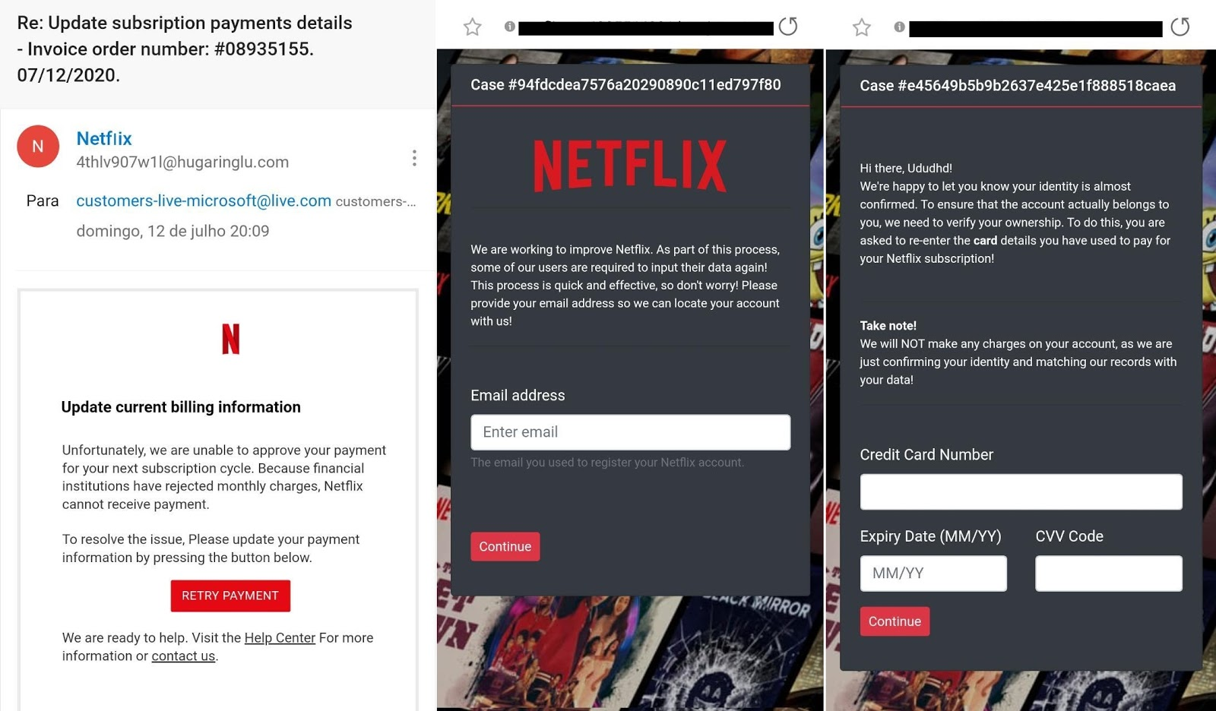
Notes:
Slide 15
We’re now going to review the entire phishing process, from the moment a message is received to the point where the Internet user is asked to enter information on a webpage.
------------------------------
The first image shows what the user initially sees on their device. The message is designed to look like it’s been sent from Netflix, a streaming service for which the user pays a monthly subscription fee. The email states that the user’s account is being suspended for lack of payment. It asks the user to pay their bill by clicking on the red “RETRY PAYMENT” button and providing certain personal information.
------------------------------
------------------------------
When the user clicks on the button, they are redirected to a website that in many ways resembles the actual Netflix site.
They’re asked to identify themselves.
Then, they’re asked to update their personal information.
------------------------------
By taking a closer look at the URL shown in the address bar, you can see that the page is not actually on the Netflix website. It’s on a phony site called “ca-consulter.com.”
------------------------------
------------------------------

Slide 16
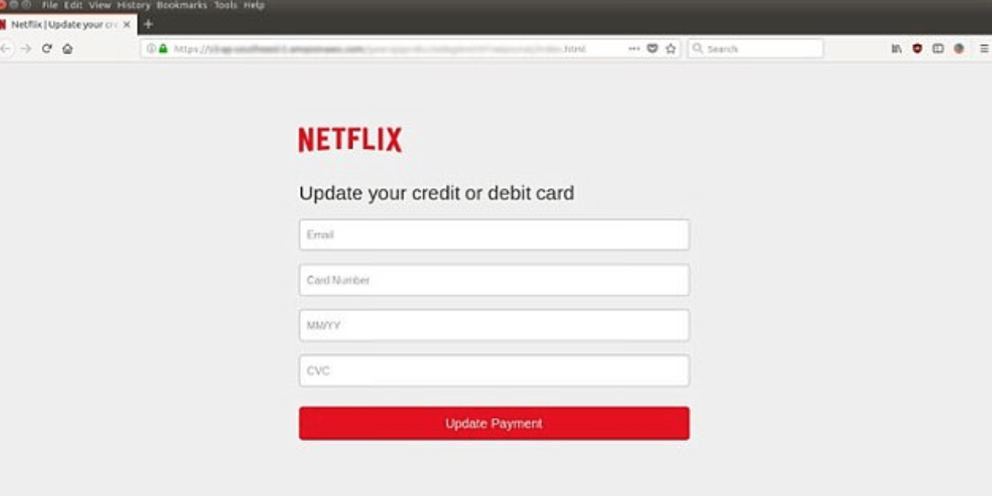
Notes:
Slide 16
------------------------------
The page goes on to ask the Internet user to choose a payment method and provide their banking information.
------------------------------
------------------------------
This information is transmitted as soon as the user clicks the red “Continue” button.
------------------------------
------------------------------
They are then redirected to the official Netflix website, leaving them with the impression that the entire transaction has been legitimate.
------------------------------
This example highlights the importance of paying attention to a website’s URL.
------------------------------

Slide 17
Notes:
Slide 17
Here’s another example that highlights the importance of paying attention to a website’s URL. The page displayed on the screen appears to be part of a Government of Canada website. You can see the official government logo and the page is laid out in the same way as those on other federal websites.
------------------------------

Slide 18
Notes:
Slide 18
But if you look closely at the URL, you’ll see that the page is actually on an insecure website called “marocgro.com.”
------------------------------
In the address bar, the browser displays a warning message that the connection to the site is not secure. A third party could view or alter any information sent or received via this site.
------------------------------

Slide 19
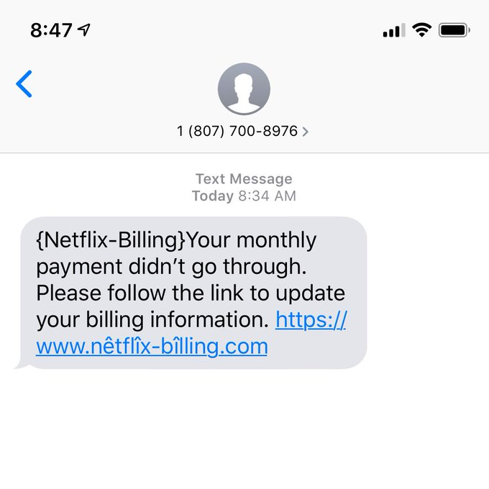
3 errors
Based on the information we had discussed, what are the warning signals that you can identify in this phishing message?
Notes:
Slide 19
Based on the information we just discussed, what red flags* can you spot in this phishing message?
------------------------------

Slide 20
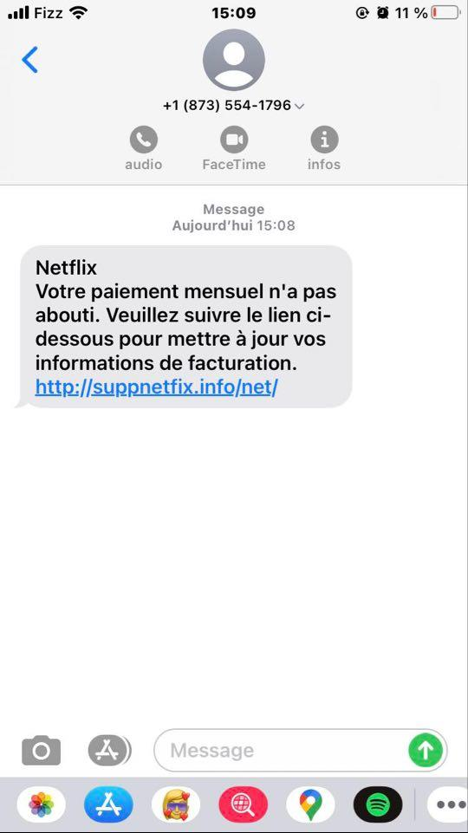
3 errors
Notes:
Slide 20
Answers
------------------------------
Unfamiliar phone number (try confirming it with a web search)
------------------------------
------------------------------
Warning message requesting personal information
------------------------------
------------------------------
Not a Netflix URL
------------------------------
------------------------------

Slide 21
3. What to do in case of doubt?
Notes:
Slide 21
Here are the steps to follow if you’re unsure about an email you’ve received.
------------------------------

Slide 22
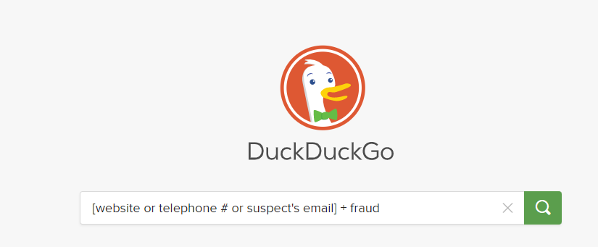
Verify the source on a search engine
Notes:
Slide 22
First, confirm the sender’s identity using a search engine.
------------------------------
Search for the word “fraud,” along with the name of the website, telephone number or email address provided.
------------------------------
You can also replace the word “fraud” with “scam” or “phishing.”
------------------------------

Slide 23
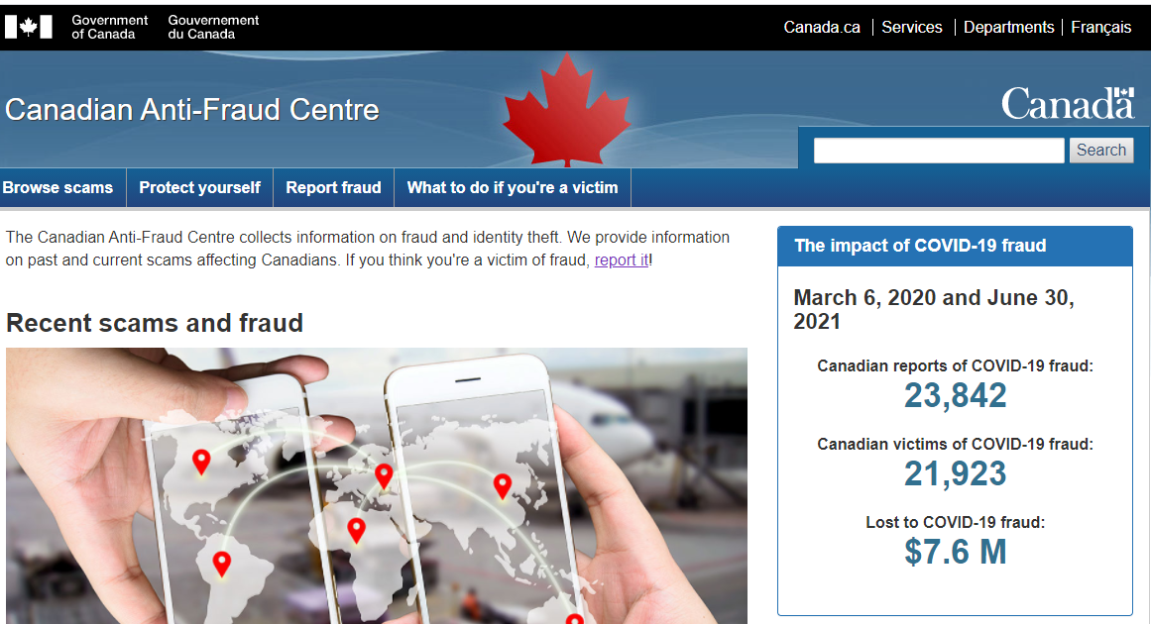
Verify the source on the anti-fraud centre
Notes:
Slide 23
------------------------------
If a web search doesn’t provide enough information, you can visit the website of the Government of Canada’s Anti-Fraud Centre.
------------------------------
You can search the information on the site, which is updated daily. You can also use the site to report a case of fraud and to find advice on how to protect yourself.
------------------------------

Slide 24
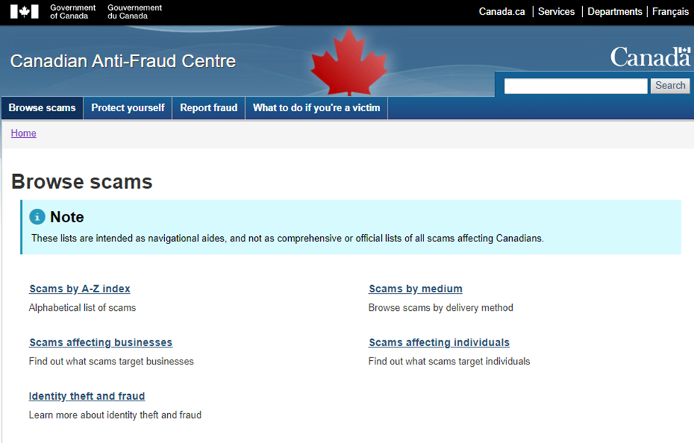
Notes:
Slide 24
There are different ways to find information on the site.
------------------------------
For example, you can browse an alphabetical list of scams, a list of scams organized by delivery method, a list of scams targeting business and a list of scams targeting individuals.
------------------------------

Slide 25
Contact the interlocutor directly
Reach the sender of the message by other means.
Notes:
Slide 25
You can also contact the sender (whether it’s a financial institution, a relative, etc.) by a means other than email. You could send a text message or call directly to confirm whether the email is legitimate.
Criminals generally prefer not to answer, to avoid identifying themselves. So, if no one answers, it’s another sign of a scam.
------------------------------

Slide 26
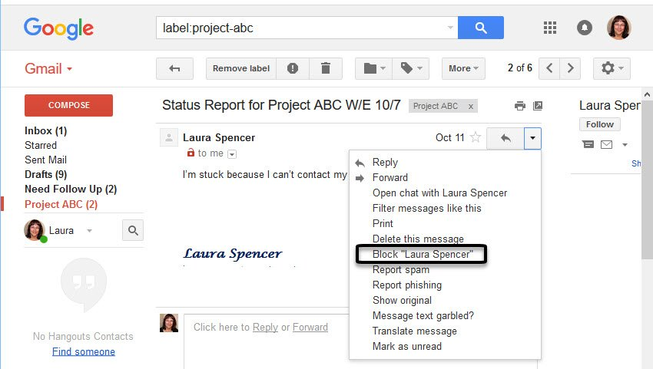
Delete and report a suspicious e-mail
Notes:
Slide 26
All email software (Outlook, Rogers, Bell, etc.) provides options for dealing with suspicious email. All these apps use similar symbols and icons. For example, here’s the Gmail interface.
------------------------------
You can either click on the “trash can” icon to delete the message directly or click on the “stop sign” icon with the exclamation point to mark the message as spam. “Spam” refers to junk email, sent in bulk to Internet users.
------------------------------
You can also click on the three small dots in the top right corner of the message.
------------------------------
The drop-down menu will include options for deleting the message and marking it as spam. You can also block the sender’s email address and/or report the message as a phishing scam.
------------------------------

Slide 27
4. What to do if you are a victim of online fraud?
Notes:
Slide 27
4. What should you do if you fall victim to an online scam?
------------------------------

Slide 28
Gather information to report the fraud
The screen name and email address of the suspect.
The social network that was used.
The address of the blog or website that was involved.
Screenshots of the messages that were received.
The photo, video or text that was distributed.
Any other relevant information.
Notes:
Slide 28
When reporting a fraud attempt, you may be asked for some of the following information (depending on the circumstances):
The sender’s screen name and email address.
The discussion forum, chat room or social network used.
The address of the blog or website.
A copy of the chat or email message.
The image, video or text you received.
Any other relevant information.
------------------------------

Slide 29
Reporting fraud is important and useful for everyone
According to the Canadian Anti-Fraud Centre, fewer than 5% of frauds are reported to authorities.
In 2019, 47,389 fraud cases were reported.
Police locale
Centre antifraude 1-888-495-8501 (numéro sans frais)
Institution bancaire
Notes:
Slide 29
According to the Canadian Anti-Fraud Centre, less than 5% of fraud cases are reported to the authorities.
In 2019, 47,389 cases were reported.
According to the Canadian Anti-Fraud Centre, this is how you should report fraud:
First, contact local police to have a case opened and make a note of the case number.
Then, in the case of bank fraud, contact your financial institution.
Finally, call the Anti-Fraud Centre’s toll-free number to report the incident. You can also report the incident on the Centre’s website.
------------------------------

Slide 30
Fraudsters pose as animal breeders TVA Nouvelles
Notes:
Slide 30
Now, let’s listen to a report on some people who recently fell victim to a phishing scam. You’ll see just how hard it was for them to realize they were being tricked!
------------------------------

Slide 31
Fraudsters who claim to be animal breeders
Which warning signals would have been able to alert you if you had been the victim in this phishing attempt?
Asking for personal information intrusively.
Asking for payment without any warranty.
Notes:
Slide 31
What are some of the warning signs that this was a scam?
------------------------------
Answers
Request for personal information.
Request for payment of a sum of money.
------------------------------

Slide 32
Fraudsters who claim to be animal breeders
Which methods you would have used to corroborate the seller’s identity?
Verify the identity on the Internet.
Read the client testimonials online.
Ask for a video call in order to see the animals and the facilities.
Consult the list of frauds on the Anti-Fraud Center’s Website.
Notes:
Slide 32
What steps could have been taken to confirm the sender’s identity?
------------------------------
Answers
Doing a search online.
Reading customer reviews.
Requesting a video call to view the animals and facilities.
Reviewing the list of frauds.
------------------------------

Slide 33
Online phishing: protect yourself from it
Beware of urgent or unexpected requests.
Read carefully all the details of the message.
Never click on links or open attachments from unknown sources.
Never send information or money: try to identify the interlocutor.
Notes:
Slide 33
Beware of urgent or unexpected requests.
Read carefully.
Don’t click on links or open attachments.
Verify the sender’s identity by contacting them directly or searching for them online.
------------------------------

Slide 34
Resources
www.antifraudcentre-centreantifraude.ca/index-eng.htm/
www.cyber.gc.ca/en/
www.getcybersafe.gc.ca/en
The sûreté du Québec : 310-4141 or * 4141
Notes:
Slide 34
We’ve reached the end of the workshop! Here are some resources that may be useful to victims of online fraud.
If you’re interested, feel free to take a screenshot!

Slide 35
Sources
Canadian Anti-Fraud Centre
The Sûreté du Québec
The SPVM Montréal
Media: Radio-Canada, Rad and TVA Nouvelles
Government of Canada: Competition Bureau
Canadian Centre for Cyber Security
Notes:
Slide 35
Here are the sources we used to develop the workshop.

Slide 36
Images sources
Google Flaticon: Freepik, Pixel perfect, iconixar, Kiranshastry, srip, Becris, Flat Icons, surang, Vitaly Gorbachev, Itim2101, Nhor Phai, mynamepong, geotatah, Dimitri Miroliubov, Tomas Knop and Zlatko Najdenovski
Notes:
Slide 36
And here are the credits for the images we used.
Thanks so much for participating!

